Slide 1


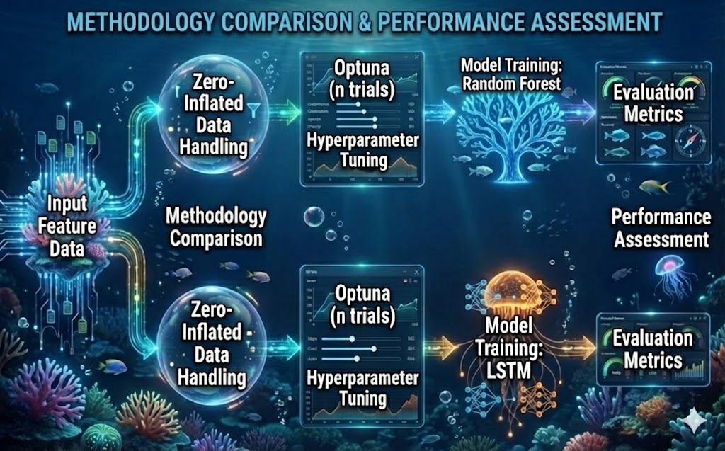
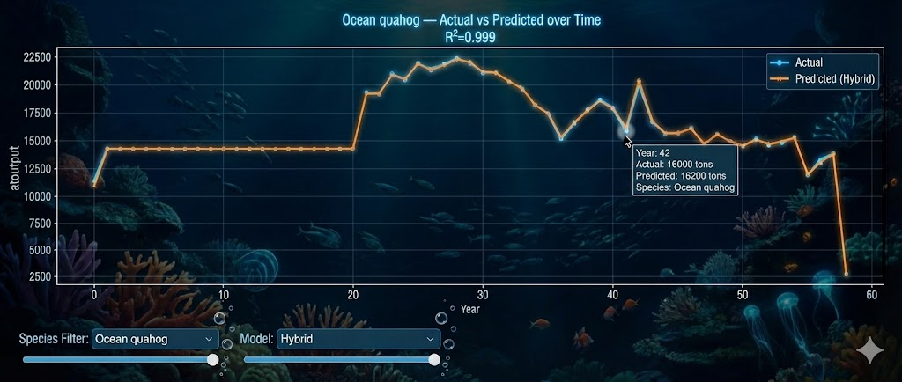
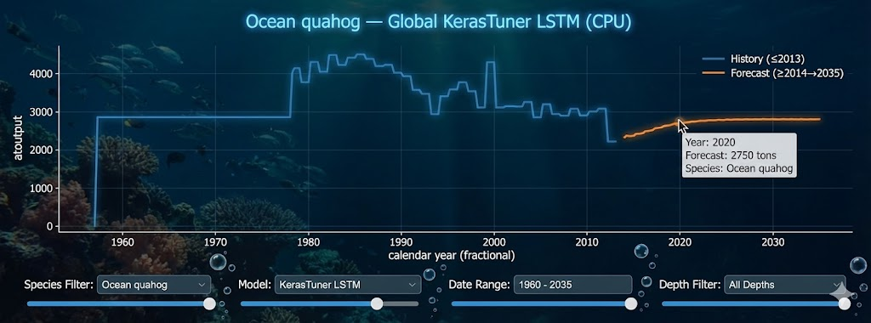
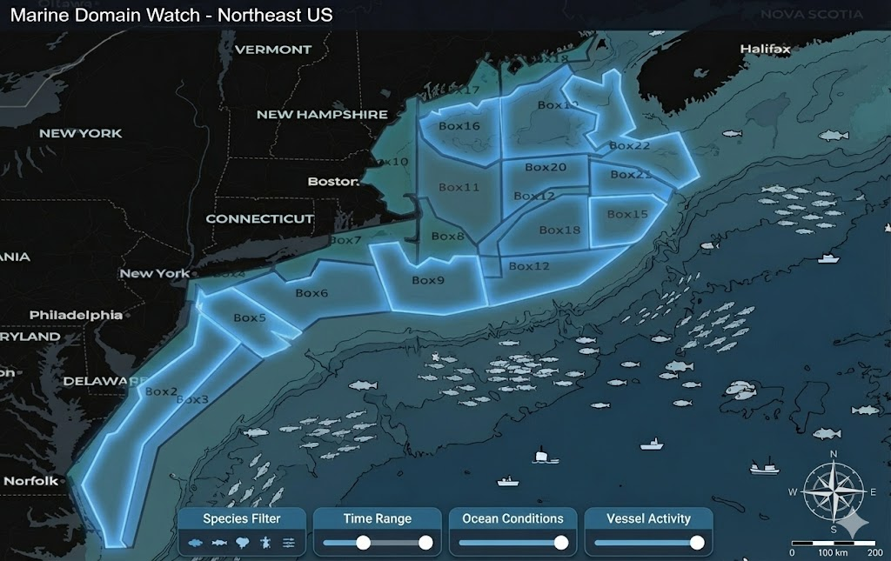
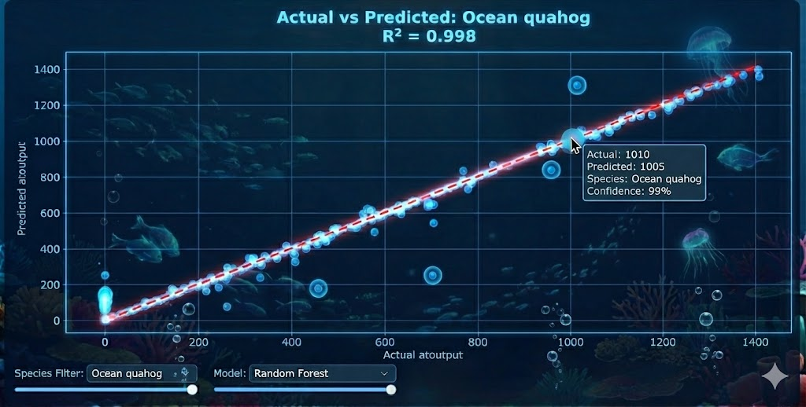
A Data-Driven Emulator for Multi-Species Biomass Prediction and Long- Term Forecasting in the Northeast U.S. Large Marine Ecosystem (NEUS)
Ajmal Abbas (aabbas1@umassd.edu), Gavin Fay
Department of Fisheries Oceanography, School for Marine Science and Technology, University of Massachusetts Dartmouth
PROJECT MOTIVATION
End to End marine ecosystem models such as Atlantis simulate multi-species biomass, trophic dynamics and fishing fleet interactions in the Northeast U.S Large Marine Ecosystem(NEUS), but their high computational cost (hours-days per scenario) limits rapid testing and long-term forecasting.
Hypothesis: A hybrid machine-learning and deep learning emulator can accurately reproduce Atlantis Neus multi-species biomass dynamics and generate reliable long term forecast at a fraction of the computational cost.
OBJECTIVES
Develop and validate a computationally efficient machine learning emulator of the Atlantis NEUS ecosystem model
Capture temporal dynamics and long-term biomass trends through deep learning to enable scalable forecasting and support fleet impact assessment and spatial generalization.
METHODS
Data & Study Design:
Analysis was based on 58 years (1957-2014) of output from Atlantis NEUS ecosystem model, including 51 species, fishing fleets, and spatial polygons, with biomass as the response variable. The dataset is high-dimensional and characterized by zero-inflated biomass distributions.
Modelling Framework:
Biomass was predicted using Random Forest regressor to capture non-linear relationships across species , fleets and time . Model Performance was optimized using Optuna Bayesian hyperparameter tuning, with hurdle style approach applied to address zero inflation.
Forecasting & Evaluation:
LSTM networks were used to model temporal biomass dynamics and generate long-term forecasts through 2035. Model performance was assessed using time-aware train-test-split, standard accuracy metrics (R² score) and visual validation via parity plots and species -level time series.
Fig 4: Actual vs prediction
Figure 2:Methodology
RESULTS
Prediction Accuracy:
The machine-learning emulator demonstrated strong predictive performance across the multi-species dataset, with the random forest component achieving ~94% overall accuracy and R² > 90% for most species (e.g., Drums & Croaker 99%, Scup 99% , Black Sea Bass 98%, Atlantic Bluefin Tuna 98%).
Model Validation:
Emulator–predicted biomass showed close agreement with Atlantis output (Fig. 3), supporting the hypothesis that the emulator can accurately reproduce Atlantis biomass dynamics. Species-specific time-series comparisons reproduced inter-annual variability and key ecological trends (Fig. 4).
Forecasting Performance
The LSTM Component produced biologically coherent long-term forecasts with no unrealistic oscillations or instability (Fig. 5), achieving strong forecast accuracy for representative species (e.g., Smooth Dogfish 88%).
Fig 5:Forecasting Graph
DISCUSSION AND CONCLUSIONS
High Predictive Accuracy: The random forest–LSTM emulator reliably reproduces Atlantis NEUS biomass dynamics and forecasts across 51 species despite heterogeneous, zero-inflated data.
Computational Efficiency: Once trained, the emulator generates biomass predictions nearly instantaneously, enabling rapid scenario exploitation and decision support, offering a scalable alternative to computationally intensive full Atlantis simulations. (Random Forest 0.9s, LSTM 2.83s)
FUTURE ENHANCEMENTS
Future work will extend the emulator to quantify fishing fleet-specific impacts on biomass across spatial polygons for multiple fishing effort scenarios.
REFERENCES AND ACKNOWLEDGEMENTS
1.Caracappa, J. C., Beet, A., Gaichas, S., Gamble, R. J., Hyde, K. J., Large, S. I., ... & Saba, V. S. (2022). A northeast United States Atlantis marine ecosystem model with ocean reanalysis and ocean color forcing. Ecological Modelling, 471, 110038.
2.Audzijonyte, A., Pethybridge, H., Porobic, J., Gorton, R., Kaplan, I., & Fulton, E. A. (2019). Atlantis: A spatially explicit end‐to‐end marine ecosystem model with dynamically integrated physics, ecology and socio‐economic modules. Methods in Ecology and Evolution, 10(10), 1814-1819.
3.Perryman, H. A., Kaplan, I. C., Blanchard, J. L., Fay, G., Gaichas, S. K., McGregor, V. L., ... & Fulton, E. A. (2023). Atlantis ecosystem model summit 2022: report from a workshop. Ecological Modelling, 483, 110442.
4.Fay, G., DePiper, G., Steinback, S., Gamble, R. J., & Link, J. S. (2019). Economic and ecosystem effects of fishing on the Northeast US shelf. Frontiers in Marine Science, 6, 133.4
Figure 1 :NEUS
Fig 3 :Residual Plot
Notes:
1️⃣ Opening (10–15 seconds) — Start here
👉 Point to the title
“Hi, I’m Ajmal Abbas from UMass Dartmouth. This poster presents a machine-learning emulator for predicting and forecasting multi-species biomass in the Northeast U.S. Large Marine Ecosystem using outputs from the Atlantis ecosystem model.”
(Pause. Make eye contact.)
2️⃣ Problem & Motivation (20–25 seconds)
👉 Point to the Introduction section
“Atlantis is a big end-to-end ecosystem model that simulates species biomass, fishing fleets and more The challenge is that it is computationally expensive - one scenario can take days or even weeks to run. That makes rapid scenario testing and long-term forecasting very difficult.”
“So the question we asked was: can we build a fast, data-driven emulator that reproduces Atlantis outputs with much lower computational cost?”
3️⃣ Hypothesis (10 seconds — Judges LOVE this)
👉 Point to the Hypothesis line
“Our hypothesis was that a hybrid machine-learning and deep-learning framework could accurately reproduce Atlantis multi-species biomass dynamics and generate reliable long-term forecasts at a fraction of the computational cost.”
(Short pause — let that land.)
4️⃣ Data & Methods (30–40 seconds)
👉 Point to Methods + workflow figure
“We trained the emulator using 58 years of Atlantis NEUS output, from 1957 to 2014, covering 51 species, multiple fishing fleets, spatial polygons, and time. Biomass was the response variable, and the data are high-dimensional and strongly zero-inflated.”
“We used a Random Forest model to predict biomass at each time step and an LSTM neural network to model temporal dynamics and forecast biomass through 2035. Hyperparameters were optimized using Bayesian tuning, and we used a time-aware train–test split for validation.”
5️⃣ Results (40–50 seconds — This wins points)
👉 Point to parity plot and time series
“The emulator performs very well across species. Overall prediction accuracy is about 94%, and most species achieve R² values above 90%.”
“The parity plots show close alignment along the one-to-one line, which tells us the model is well calibrated. Species-specific time series show that the emulator reproduces inter-annual variability and key ecological trends seen in Atlantis.”
👉 Point to forecasting figure
“For long-term forecasting, the LSTM produces biologically coherent projections through 2035, without unrealistic oscillations. For example, Smooth Dogfish achieves about 88% forecast accuracy.”
6️⃣Computational Advantage (15–20 seconds)
👉 Point to runtime figure
“One major advantage is speed. Once trained, the emulator generates predictions almost instantly, compared to the high computational cost of full Atlantis simulations. This makes rapid scenario exploration and decision support feasible.”
7️⃣Discussion & Take-Home Message (20–25 seconds)
👉 Point to Discussion section
“Overall, the results support our hypothesis. The emulator accurately reproduces Atlantis biomass dynamics while dramatically reducing computational cost.”
“This shows that data-driven ecosystem emulation can serve as a scalable alternative to full mechanistic models, and it provides a foundation for future work on fleet-impact analysis, spatial generalization, and habitat-based decision support.”
8️⃣ Close Strong (5–10 seconds)
“Thank you — I’d be happy to discuss the model, results, or future extensions.”
(Stop talking. Smile.)

